Slide 1

Programming Concepts
Introduction Part 1

Slide 2
What is a computer program?

Slide 3
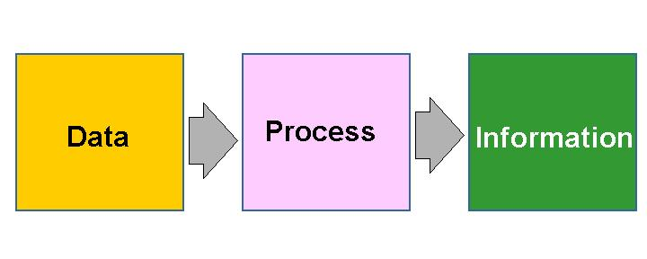
What is a computer program?
Tells the computer what to do
Turns a dumb machine into the most powerful tool!
A list of detailed instructions
Processes data to give us information

Slide 4
Roles
The programmer/developer (YOU) writes these programs
The end-user is a non-technical person who needs the results of your programs

Slide 5

Programming Misconceptions
Myth 1
Only Math experts can program computers
Myth 2
Computers make mistakes
Myth 3
Computers are difficult to program

Slide 6
What is a programming language?

Slide 7

What is a programming language?
A language of communication between developer and computer
Used to write programs
Purpose is similar to that of natural (human languages)
But…important differences (formally defined, unambiguous and simple)

Slide 8
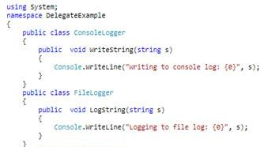
What is a programming language?
A programming language is human-readable but machine-understandable at the same time
That is, the instructions are English-like but they still conform to a pre-defined set of rules according to the programming language you choose.

Slide 9
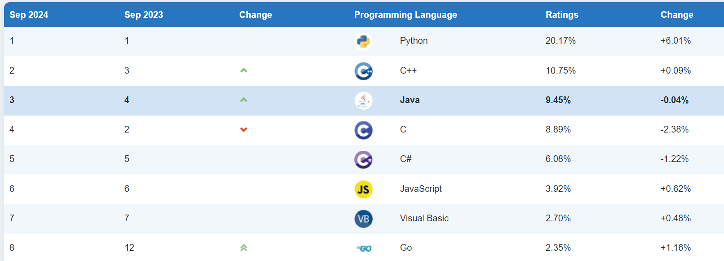
Different Programming Languages
TIOBE ratings are calculated by counting hits of the most popular search engines. There are 25 search engines that are used to calculate the TIOBE index. The TIOBE Programming Community index is an indicator of the popularity of programming languages.

Slide 10
Different Programming Languages
Why do we have a lot of programming languages?

Slide 11
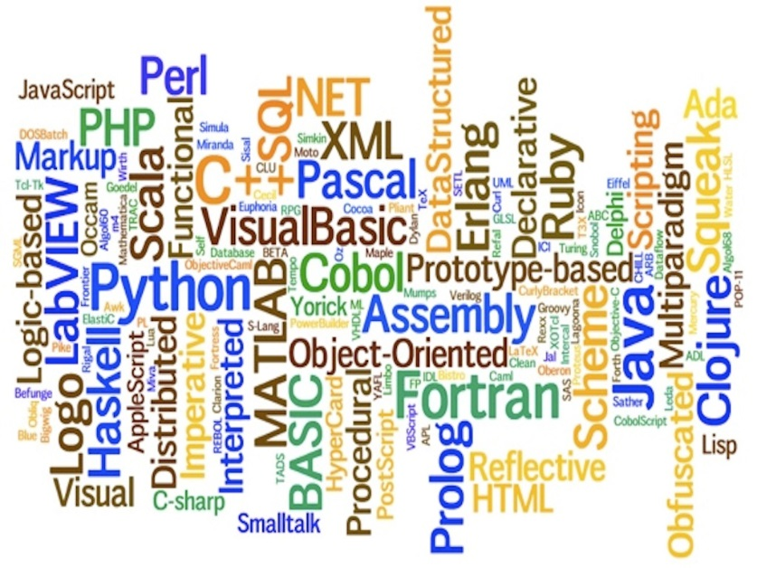
Different Programming Languages
Why do we have a lot of programming languages?
Different tools for different jobs
Developers have tastes

Slide 12
Some popular languages
Java
C#
C and C++
Pascal
Fortran
Perl
PHP
Python
JavaScript
Have a look at: http://programming.dojo.net.nz/resources/programming-language-comparison/index

Slide 13
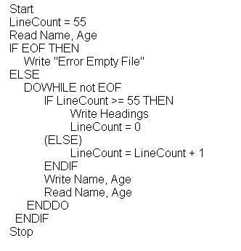
Similar Programming Concepts
All programming languages have similar concepts!
In fact, many programs are initially written/designed in pseudo-code

Slide 14
Similar Programming Concepts
The 5 basic concepts of all programming languages:
Variables
Control Structures
Data Structures
Syntax
Tools

Slide 15
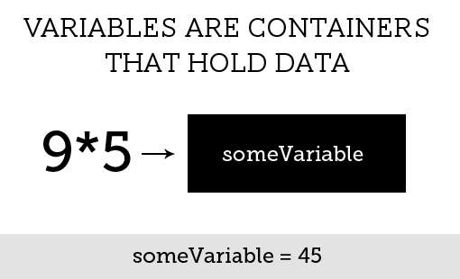
Variables
A variable stores a value to be used in a program
Is usually given a name

Slide 16
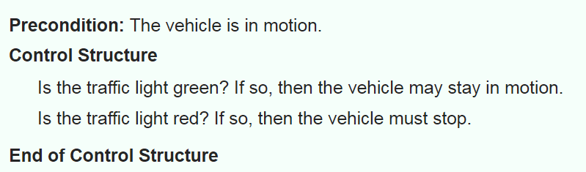
Control Structures
A piece of code that makes a decision on what to do next

Slide 17
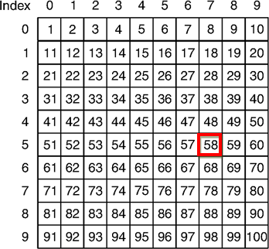
Data Structures
Sometimes more complicated structures than variables are required to store data
These can be classes or other constructs e.g. arrays

Slide 18
Syntax
The set of keywords and symbols that can be used in a programming language
Also, rules about how terms can be formed
What varies between different languages

Slide 19
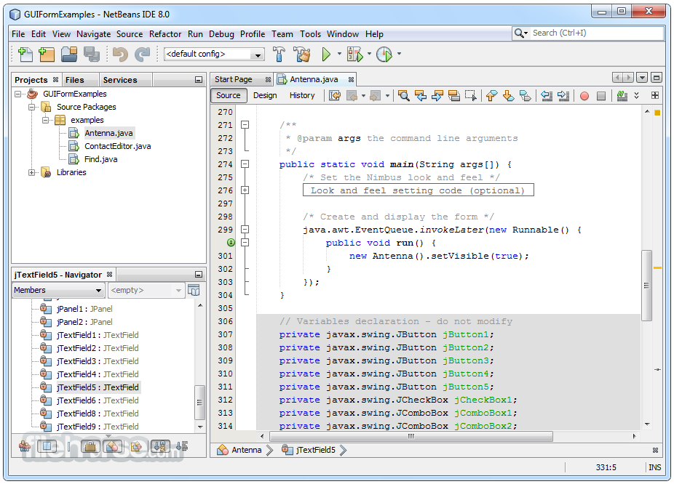
Tools
Companies (and groups of enthusiasts) have created tools to help us develop programs using our chosen programming language
The most important tool would be the program used to code the program – IDE (in next lesson)
Amongst others, it has features to help us get the syntax right.

Slide 20
Activity
Look at the two code snippets below:
class helloworld {
static void Main (string[] args){
Console.WriteLine("Hello World");
}
}
class helloworld {
public static void main (String args []) {
System.out.println("Hello World");
}
}
What are the differences and the similarities between them?
Notes:
One in c# other in java

Slide 21

Questions

